Slide 1
Vectors
Chapter 4

Slide 2
Vectors and Scalars
What is a vector?
  A vector is a quantity that has both magnitude (size, quantity, value, etc.) and direction.
What is a scalar?
  A quantity that has only magnitude.

Slide 3
Vector vs. Scalar
Vectors
  Displacement (d)
  Velocity (v)
  Weight / Force (F)
  Acceleration (a)
Scalars
  Distance (d)
  Speed (v)
  Mass (m)
  Time (t)
Note: Vectors are normally represented in bold face while scalars are not.

Slide 4
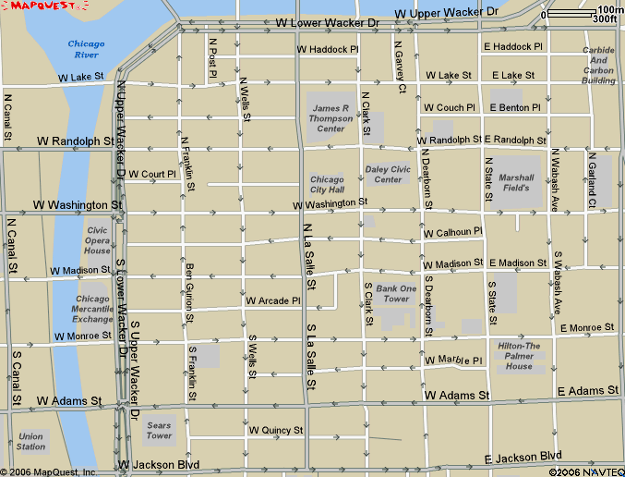
Vector vs. Scalar (Distance vs. Displacement)
What is the total distance traveled?
770 m
d_{Total} = 1,710 m
270 m
670 m
868 m
The resultant will always be less than or equal to the scalar value.
What is the total displacement?
d = 868 m NE

Slide 5
Properties of Vectors
Each vector is represented by an arrow with a length that is proportional to the magnitude of the vector.
  For example, a displacement of 4 meters can be represented by an 8 cm vector using a scale where 1.0m = 2.0cm.
Each vector has a direction associated with it.
A vector can be moved anywhere in a plane as long as the magnitude and direction are not changed.
8 cm
40º

Slide 6
Properties of Vectors
Two vectors are considered equal if they have the same magnitude and direction.
If the magnitude and/or direction are different, then the vectors are not considered equal.
A = B
A
B
A
A ≠ B
B

Slide 7
Properties of Vectors (cont.)
Two or more vectors can be added together to form a resultant. The resultant is a single vector that replaces the other vectors.
The maximum value for a resultant vector occurs when the angle between them is 0°.
The minimum value for a resultant vector occurs when the angle between the two vectors is 180°.
Resultant
B
+
=
A
B
A
+
=
4 m
7 m
3 m
7 m
180°
+
=
4 m
3 m
1 m

Slide 8
Properties of Vectors (cont.)
The equilibrant is a vector with the same magnitude but opposite in direction to the resultant vector.
Vectors are concurrent when they act on a point simultaneously.
A vector multiplied by a scalar will result in a vector with the same direction.
-R
R
P
F = ma
vector
scalar
vector

Slide 9
Adding & Subtracting Vectors
“TIP-TO-TAIL”
If the vectors occur in a single dimension, just add or subtract them.
+
=
4 m
7 m
3 m
7 m
+
=
-
4 m
7 m
3 m
7 m
When adding vectors, place the tip of the first vector at the tail of the second vector.
When subtracting vectors, invert the second one before placing them tip to tail.

Slide 10
Adding Vectors using the Pythagorean Theorem
If the vectors occur such that they are perpendicular to one another, the Pythagorean theorem may be used to determine the resultant.
5 m
3 m
+
=
4 m
3 m
4 m
A² + B² = C²
(4m)² + (3m)² = (5m)²
Tip to Tail
When adding vectors, place the tip of the first vector at the tail of the second vector.

Slide 11
Example 1:
The vector shown to the right represents two forces acting concurrently on an object at point P. Which pair of vectors best represents the resultant vector?
Resultant
P
P
P
(a)
(b)
P
P
(c)
(d)

Slide 12
How to Solve:
Note: The resultant is always drawn such that it starts at the tail of the first vector and ends at the tip of the second vector.
P
1. Add vectors by placing them Tip to Tail.
or
P
P
2. Draw the resultant.
This method is also known as the Parallelogram Method.
Resultant
P

Slide 13
Coordinate System – Component Vectors
Instead of using a graphical means, a coordinate system can be used to add vectors together
In a coordinate system, the vectors that lie along the x and y axes are called component vectors.
The process of breaking a vector into its x and y axis components is called vector resolution.
To break a vector into its component vectors, all that is needed is the magnitude of the resultant vector and its direction(θ).
y
R_{y}
R
θ
R_{x}
x

Slide 14
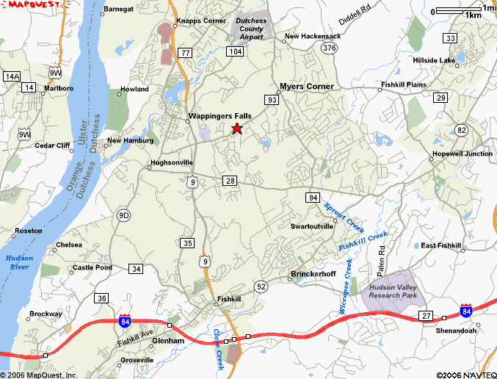
Defining position using coordinates
North
y
R = 12.6 km
R_{y} = 9.27 km
θ = 47.4°
0
East
R_{x} = 8.53 km
x

Slide 15
How to set up your vector
Choose a point for the origin. Typically this will be at the tail of the vector.
The direction will be defined by the angle that the resultant vector makes with the x-axis.
y
Origin
R
θ
(0,0)
x

Slide 16
Determining the x and y Component Vectors
Use SOH CAH TOA to find the x and y components.
Since:
  cos θ = adj/hyp = R_{x}/R
  sin θ = opp/hyp = R_{y}/R
Then:
  R_{x} = R cos θ
  R_{y} = R sin θ
y
Origin
R
R_{y}
θ
(0,0)
R_{x}
x

Slide 17
Determining the x and y Component Vectors.
North
  If you know the resultant vector and the direction, then you can find the x and y components as follows:
  R_{x} = R cos θ
  R_{x} = (12.6km)(cos 47.4°)
  R_{y} = R sin θ
  R_{y} = (12.6km)(sin 47.4°)
y
R = 12.6 km
R_{y} = 9.27 km
θ = 47.4°
0
East
R_{x} = 8.53 km
x

Slide 18

Determining the Resultant using the Component Vectors
North
  If you know the x and y components, then you can find the resultant using the Pythagorean Theorem as follows:
  $$R^{2}={R_{x}^{}}^{2}+{R_{y}^{}}^{2}$$
  $$R=\sqrt{{R_{x}^{}}^{2}+{R_{y}^{}}^{2}}$$
  $$R=\sqrt{{(8.53km)}^{2}+{(9.27km)}^{2}}$$
  $$R=12.6 km$$
y
R = 12.6 km
R_{y} = 9.27 km
θ
0
East
R_{x} = 8.53 km
x

Slide 19

Determining the Direction using the Component Vectors
North
  To find the direction use basic trig as follows:
  $\sin{θ}=\frac{opp}{hyp}=\frac{R_{y}^{}}{R};\cos{θ}=\frac{adj}{hyp}=\frac{R_{x}^{}}{R};$ $\tan{θ}=\frac{opp}{adj}=\frac{R_{y}^{}}{R_{x}^{}}$
  $$\tan{θ}=\frac{9.27 km}{8.53 km}$$
  $$θ=\tan^{−1}\left(\frac{9.27 km}{8.53 km}\right)=47.4°$$
y
R = 12.6 km
R_{y} = 9.27 km
θ = 47.4°
0
East
R_{x} = 8.53 km
x

Slide 20
Defining the Coordinates
Choose a direction for the x and y axes
  For projectile motion where objects travel through the air, choose the x-axis for the ground or horizontal direction and the y-axis for motion in the vertical direction.
  For motion along the surface of the Earth, choose the East direction for the positive x-axis and North for the positive y-axis.
North
Upwards
+ y
- x
+ x
West
To the Left
East
To the Right
- y
Downwards
South

Slide 21
Example 2:
A bus travels 23 km on a straight road that is 30° North of East. What are the component vectors for its displacement?
d = 23 km
d_{x} = d cos θ
d_{x} = (23 km)(cos 30°)
d_{x} = 19.9 km
d_{y} = d sin θ
d_{y} = (23 km)(sin 30°)
d_{y} = 11.5 km
y
North
d
d_{y}
θ = 30°
East
d_{x}
x

Slide 22
Algebraic Addition
In the event that there is more than one vector, the x-components can be added together, as can the y-components to determine the resultant vector.
y
R
R_{x} = a_{x} + b_{x} + c_{x}
R_{y} = a_{y} + b_{y} + c_{y}
R = √R_{x}² + R_{y}²
c_{y}
c
b
b_{y}
a
a_{y}
a_{x}
b_{x}
c_{x}
x
Does the order matter?

Slide 23
Algebraic Addition (Does the order matter?)
Order does not matter. We can add the vectors up as we did originally, or in any other order, and the Resultant will still be the same!
y
a
R
b
c
x

Slide 24

















Geometric/Graphical Representation of Vectors
Remember to add them tip-to-tail.
The resultant is always drawn from the tail of the first vector to the tip of the last.
The commutative property allows you to add any number of vectors in any order you want.
$$\vec{B}$$
$$\vec{A}$$
$$\vec{C}$$
$$\vec{B}$$
$$\vec{C}$$
$$\vec{B}$$
$$\vec{E}$$
$$\vec{A}$$
$$\vec{D}$$
$$\vec{E}$$
$$\vec{R}$$
$$\vec{D}$$
$$\vec{A}$$
$$\vec{C}$$
$$\vec{R}$$
$$\vec{R}=\vec{A}+\vec{B}+\vec{C}+\vec{D}+\vec{E}$$
$$\vec{R}=\vec{A}+\vec{D}+\vec{C}+\vec{E}+\vec{B}$$

Slide 25
Key Ideas
Vector: Magnitude and Direction
Scalar: Magnitude only
When drawing vectors:
  Scale them for magnitude.
  Maintain the proper direction.
Vectors can be analyzed graphically or by using coordinates.

Slide 26
Subtracting Vectors using the Pythagorean Theorem
Tip to Tail
4 m
-
=
4 m
A
3 m
B
3 m
5 m
A² + B² = C²
(4m)² + (3m)² = (5m)²
When subtracting vectors, invert the second one before adding them tip to tail.

Slide 27
Law of Cosines
If the angle between the two vectors is more or less than 90º, then the Law of Cosines can be used to determine the resultant vector.
Tip to Tail
θ = 80º
7 m
θ
5 m
+
=
7 m
5 m
C
C² = A² + B² – 2ABCos θ
C² = (7m)² + (5m)² – 2(7m)(5m)Cos 80º
C = 7.9 m

